Slide 1
IoT프로그래밍 5주차 과제
반 YA 학번: 20202296 이름: 전채린

Slide 2
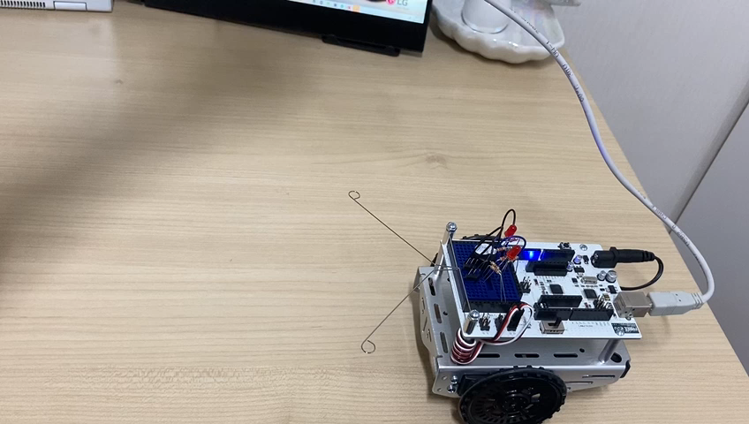
과제1 30Cm 전진, 90도 우회전 반복하여 제자리로 돌아오기 동영상

Slide 3
과제1 스케치
/* Servo13 */
/* 사용자 함수로 주행하기 */
/* 30cm 전진, 90도 우회전 반복하여 제자리로 돌아오기 */
#include <Servo.h> // Include servo library
Servo servoLeft; // Declare left and right servos
Servo servoRight;
void setup() { // Built-in initialization block
tone(4, 3000, 1000); // Play tone for 1 seconds
delay(1000); // Delay to finish tone
servoLeft.attach(13); // Attach left signal to pin 13
servoRight.attach(12); // Attach right signal to pin 12
for(int i=0; i<4; i++) {
maneuver(200, 200, 2000); // Forward 2 seconds
maneuver(200, -200, 600); // Right 0.6 seconds
}
maneuver(0, 0, -1); // Disable servors
}
void loop() { // Main loop auto-repeats
// Empty, nothing needs repeating
}
void maneuver(int speedLeft, int speedRight, int msTime)
{ // speedLeft, speedRight ranges: Backward Linear Stop Linear Forward
// -200 -100...0...100 200
servoLeft.writeMicroseconds(1500+speedLeft); // Set left servo speed
servoRight.writeMicroseconds(1500-speedRight); // Set right servo speed
if(msTime == -1) // if msTime = -1
{
servoLeft.detach(); // Stop servo signals
servoRight.detach();
}
delay(msTime); // Delay for msTime
}

Slide 4
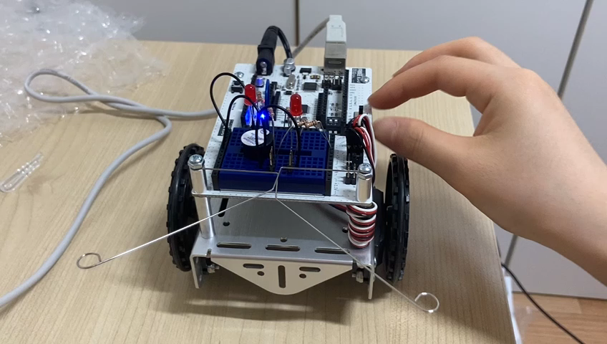
과제2 동작 영상
1. 더듬이 누르지 않았을 때

Slide 5
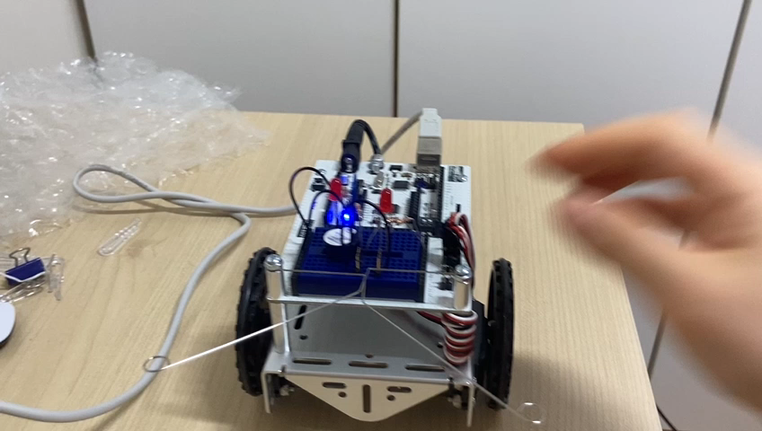
과제2 동작 영상
2. 오른쪽 더듬이 눌렀을 때

Slide 6
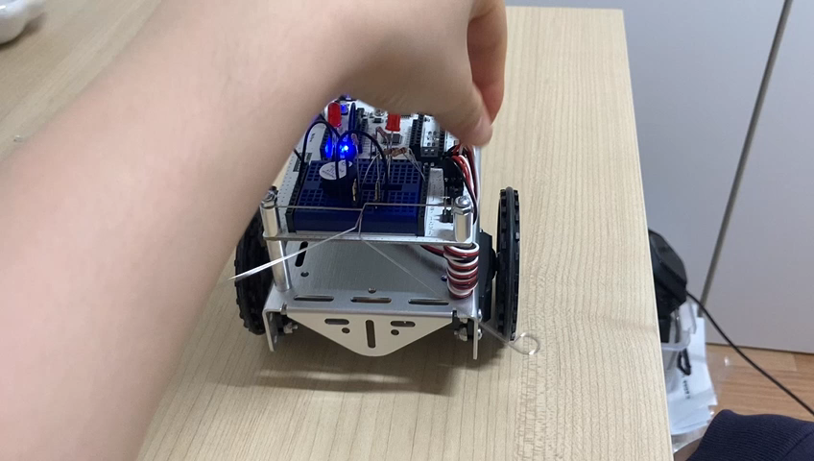
과제2 동작 영상
2. 왼쪽 더듬이 눌렀을 때

Slide 7
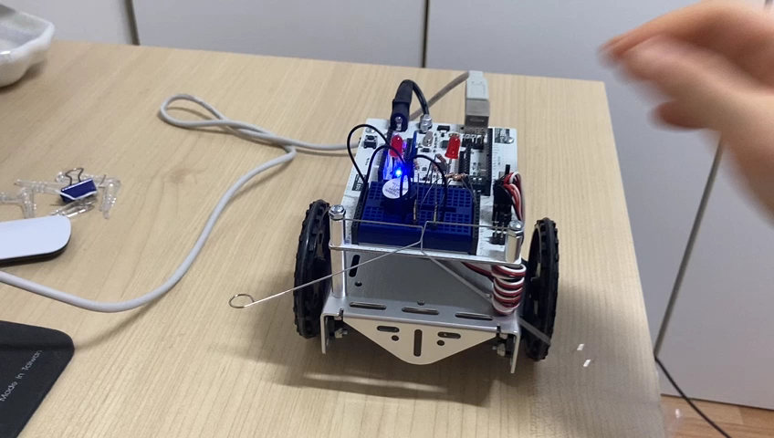
과제2 동작 영상
4. 두 더듬이 눌렀을 때

Slide 8
과제2 스케치
/* Whisker04 */
/* 더듬이 주행 스케치
* LED 제어와 모터 제어를 같이
*/
#include <Servo.h> // Include servo library
Servo servoLeft; // Declare left and right servos
Servo servoRight;
void setup() { // Built-in initialization block
pinMode(7, INPUT); // Set right whisker pin to input
pinMode(5, INPUT); // Set left whisker pin to input
pinMode(8, OUTPUT); // Left LED indicator -> output
pinMode(2, OUTPUT); // Right LED indicator -> output
tone(4, 3000, 1000); // Play tone for 1 second
delay(1000); // Delay to finish tone
servoLeft.attach(13); // Attach left signal to pin 13
servoRight.at.attach(12); // Attach right signal to pin 12
Serial.begin(9600); // Set serial data rate to 9600
}
void loop() { // Main loop auto-repeats
byte wLeft = digitalRead(5); // Copy left result to wLeft
byte wRight = digitalRead(7); // Copy right result to wRight
if((wLeft == 0) && (wRight == 0)) { // if both whiskers contact
digitalWrite(8, HIGH); // Left LED on
digitalWrite(2, HIGH); // Right LED on
backward(1000); // Back up 1 second
turnLeft(800); // Turn left about 120 degrees
digitalWrite(8, LOW); // Left LED off
digitalWrite(2, LOW); // Left LED off
}
else if(wLeft == 0) { // If only left whisker contact
digitalWrite(8, HIGH); // Left LED on
backward(1000); // Back up 1 second
turnRight(400); // Turn right about 60 degrees
digitalWrite(8, LOW); // Left LED off
}
else if(wRight == 0) { // If only right whisker contact
digitalWrite(2, HIGH); // Right LED on
backwar(1000); // Back up 1 second
turnLeft(400); // Turn left about 60 ms
digitalWrite(2, LOW); // Left LED off
}
else // Otherwise, no whisker contact
forward(20); // Forward 1/50 of a second
}

Slide 9
과제2 스케치
void forward(int time) // Forward function
{
servoLeft.writeMicroseconds(1700); // Left wheel counterclockwise
servoRight.writeMicroseconds(1300); // Right wheel clockwise
delay(time); // Maneuver for time ms
}
void turnLeft(int time) // Left turn function
{
servoLeft.writeMicroseconds(1300); // Left wheel clockwise
servoRight.writeMicroseconds(1300); // Right wheel clockwise
delay(time); // Maneuver for time ms
}
void turnRight(int time) // Right turn function
{
servoLeft.writeMicroseconds(1700); // Left wheel counterclockwise
servoRight.writeMicroseconds(1700); // Right wheel counterclockwise
delay(time); // Maneuver for time ms
}
void backward(int time) // Backward function
{
servoLeft.writeMicroseconds(1300); // Left wheel clockwise
servoRight.writeMicroseconds(1700); // Right wheel counterclockwise
delay(time); // Maneuver for time ms
}

